Slide 1


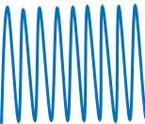


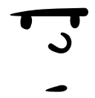
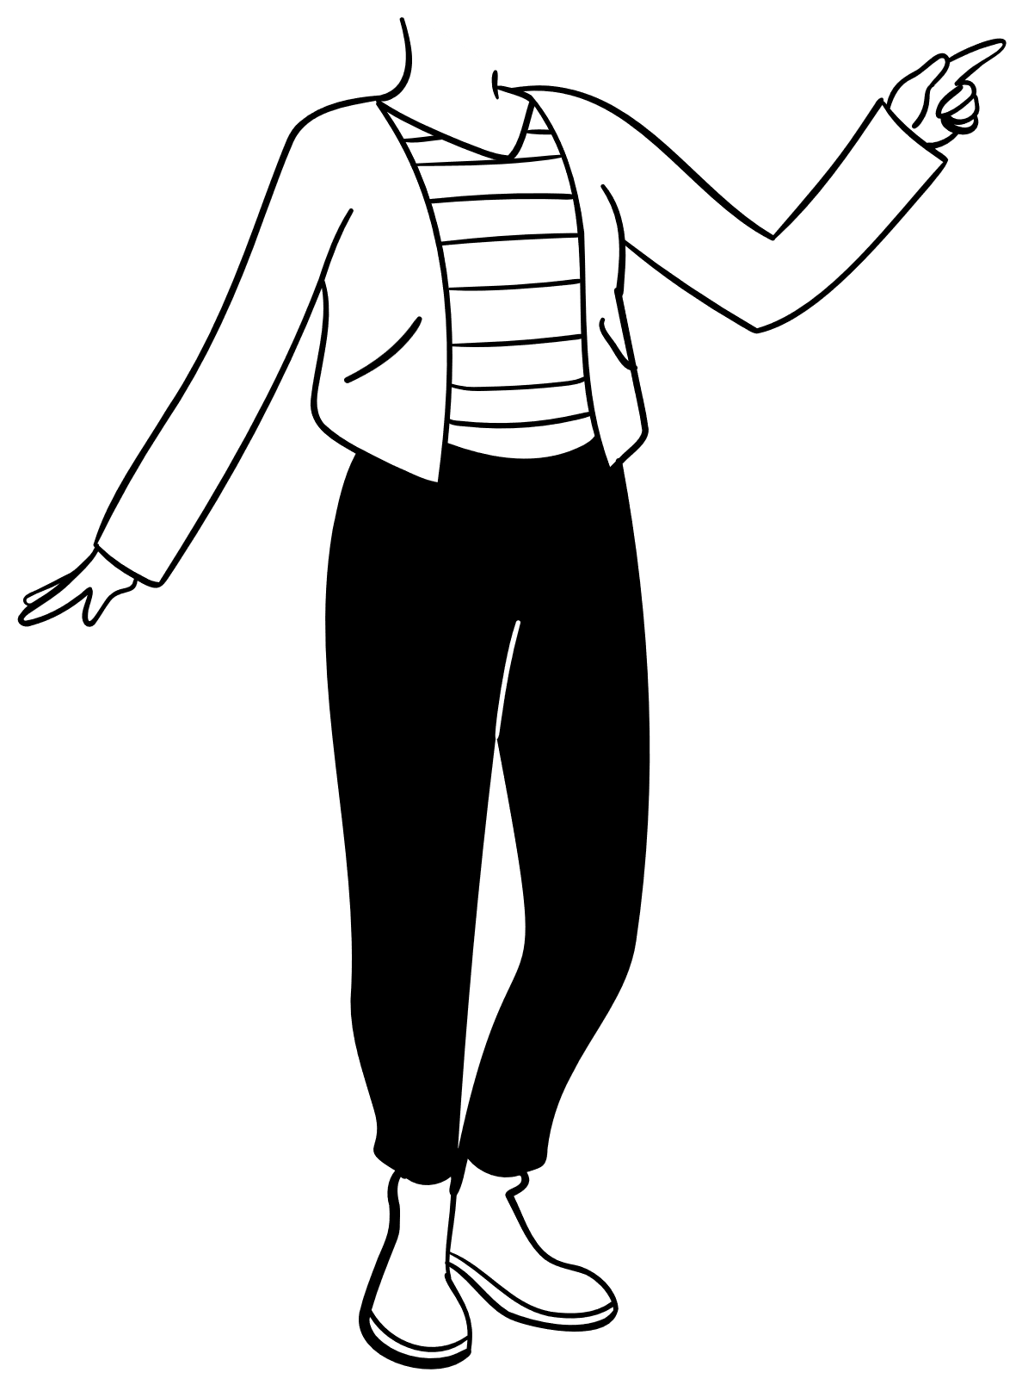
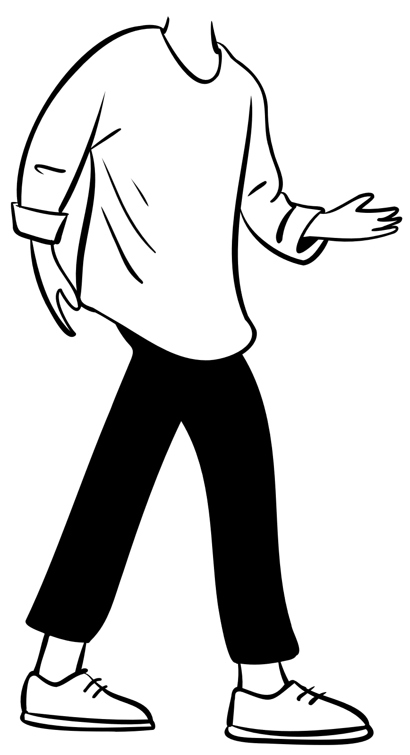
Objects moving away
Waves appear longer
Objects coming towards
Waves appear shorter
Redshift
Blueshift

Slide 2
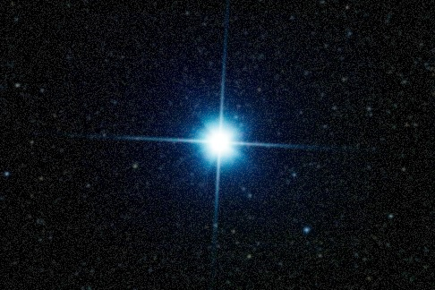
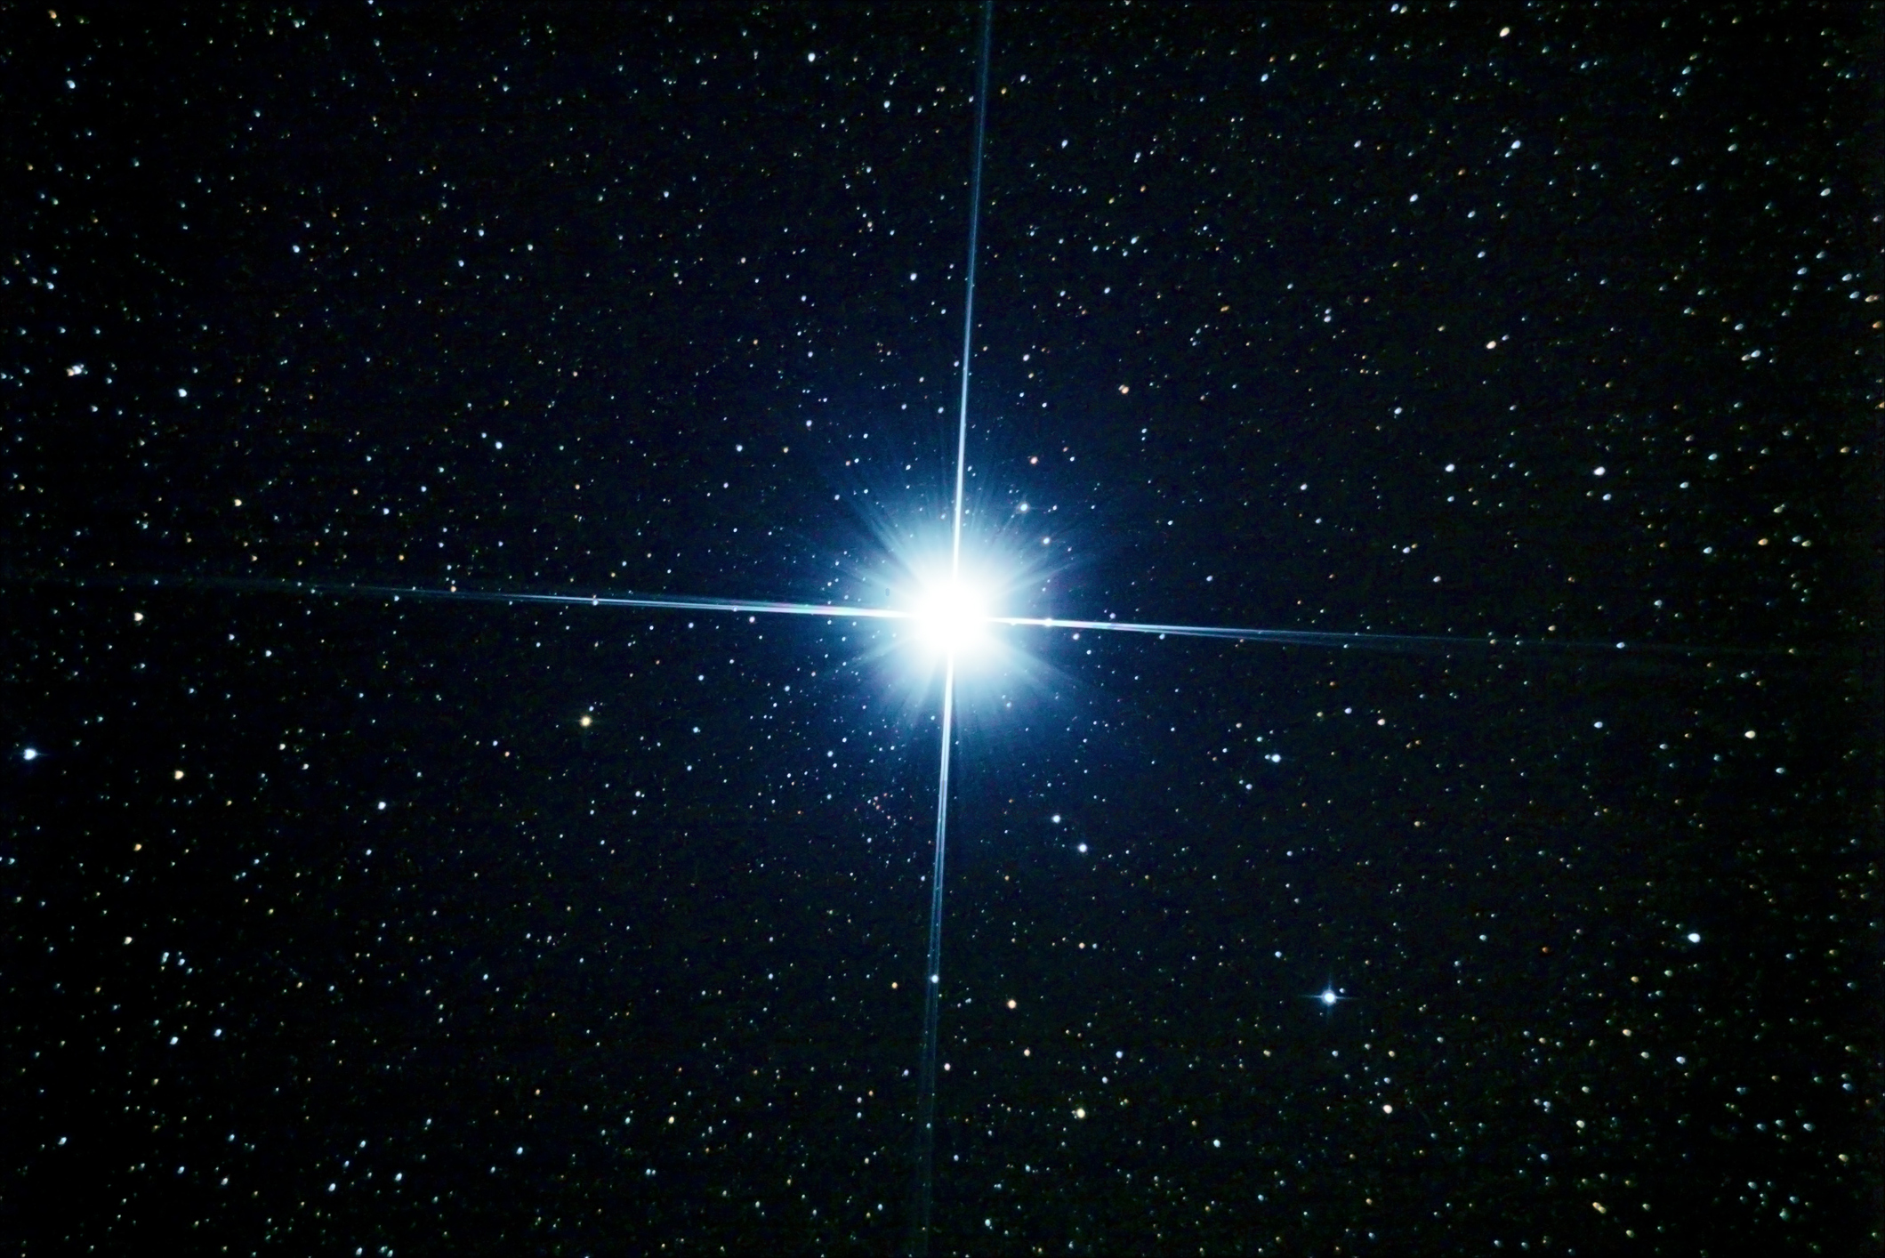

Filter with Low Resolution
(Longer Wavelength)
Image blurred to match the filter with Low Resolution
Filter with High Resolution
(Shorter Wavelength)

Slide 3
Notes:
import numpy as np
import matplotlib.pyplot as plt
from scipy.stats import norm
plt.rcParams['font.family'] = 'Calibri'
x = np.arange(0, 1, 0.01)
y = norm.pdf(x, 0.5, 0.1)
y_2 = norm.pdf(x, 0.5, 0.09)
y_3 = norm.pdf(x, 0.5, 0.14)
plt.figure(dpi=500)
plt.plot(x, y_2, color='tab:orange')
plt.plot(x, y, color='sandybrown')
plt.plot(x, y_3, color='peachpuff')
# Place text saying 'High Resolution' at the point (0.8, 4)
plt.text(0.85, 4.2, 'High Fliter Resolution', ha='center', va='center', fontsize=12)
plt.text(0.85, 1.4, 'Low Fliter Resolution', ha='center', va='center', fontsize=12)
# Place an arrow at the point (0.85, 4.2) pointing to point (0.85, 1.4)
plt.annotate('', xy=(0.85, 1.6), xytext=(0.85, 4.), arrowprops=dict(arrowstyle='->', lw=1.5, color='black'))
# remove all spines
plt.gca().spines['top'].set_visible(False)
plt.gca().spines['right'].set_visible(False)
plt.gca().spines['left'].set_visible(False)
plt.gca().spines['bottom'].set_visible(False)
# remove all ticks and labels
plt.tick_params(axis='both', which='both', bottom=False, top=False, left=False, right=False)
plt.xticks([])
plt.yticks([])
plt.tight_layout()
plt.show()

Slide 4
Notes:
import numpy as np
from astropy.modeling.functional_models import Moffat1D
from scipy.stats import norm
import matplotlib.pyplot as plt
plt.rcParams['font.family'] = 'Calibri'
x = np.arange(0, 1, 0.001)
y = norm.pdf(x, 0.5, 0.1)
y_m = Moffat1D(amplitude=4, x_0=0.5, gamma=0.16, alpha=3.7)(x)
plt.figure(dpi=500)
plt.plot(x, y, color=tab:orange', label='Gaussian')
plt.plot(x, y_m, color='darkgreen', label='Moffat')
# # Place text saying 'High Resolution' at the point (0.8, 4)
# plt.text(0.85, 4.2, 'High Fliter Resolution', ha='center', va='center', fontsize=12)
# plt.text(0.85, 1.4, 'Low Fliter Resolution', ha='center', va='center', fontsize=12)
# # Place an arrow at the point (0.85, 4.2) pointing to point (0.85, 1.4)
# plt.annotate('', xy=(0.85, 1.6), xytext=(0.85, 4.), arrowprops=dict(arrowstyle='->', lw=1.5, color='black'))
# remove all spines
plt.gca().spines['top'].set_visible(False)
plt.gca().spines['right'].set_visible(False)
plt.gca().spines['left'].set_visible(False)
plt.gca().spines['bottom'].set_visible(False)
# remove all ticks and labels
plt.tick_params(axis='both', which='both', bottom=False, top=False, left=False, right=False)
plt.xticks([])
plt.yticks([])
plt.legend(frameon=False, loc='upper right', fontsize=12)
plt.tight_layout()
plt.show()

Slide 5
